Slide 1
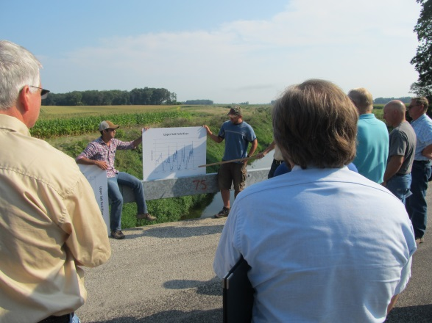
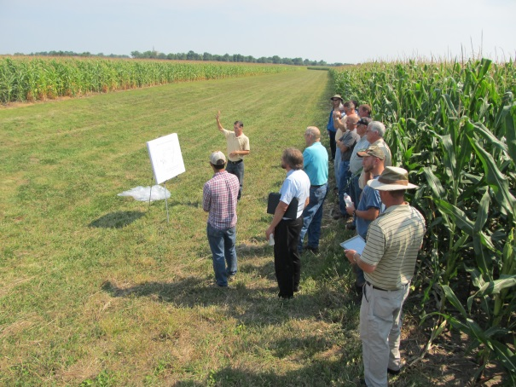
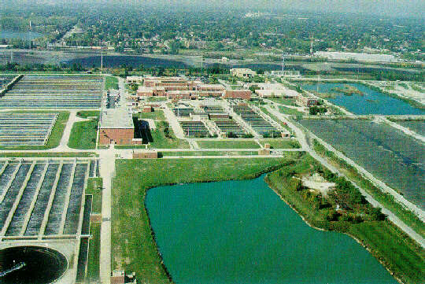
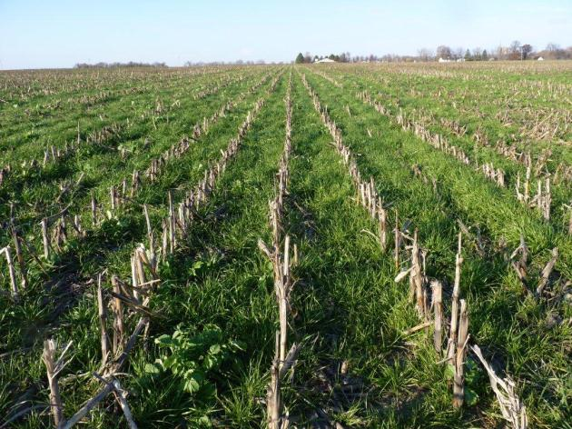
Science Assessment to Support an Illinois Nutrient Reduction Strategy
Mark David, Greg McIsaac, George Czapar, Gary Schnitkey, Corey Mitchell
University of Illinois at Urbana-Champaign
October 18, 2013
11-08-12

Slide 2
Riverine N and P Fluxes
 | Water | Nitrate-N | Total N | DRP | Total P
 | 10¹² ft³ yr⁻¹ | million lb N or P yr⁻¹
David & Gentry (2000) | 1.6 |  | 538 |  | 31.3
1980-1996 | 1.70 | 404 | 527 | 15.4 | 34.0
1997-2011 | 1.72 | 410 | 536 | 18.5 | 37.5
Urban runoff |  | 6.0 | 8.3 |  | 1.5
Point sources |  | 75.2 | 87.3 |  | 18.1
 |  | Percent of 1997-2011 load
Point sources |  | 18.4 | 16.3 |  | 48
David & Gentry (2000) |  |  | 16 |  | 47

Slide 3
Illinois Nutrient Sources

Slide 4
Point Source P Estimates
Point Source Limit (mg P/L) | million lb of P reduced | % of target (18.8 million lb P)
All majors to 1 mg/L standard (0.7 mg P/L actual) | 10.4 | 55
Top 20 majors to 0.7 | 6.1 | 32
Top 30 majors to 0.7 | 7.0 | 37
Top 50 majors to 0.7 | 7.8 | 41
All majors to 0.3 | 13.1 | 70
Top 20 majors to 0.3 | 8.0 | 42
Top 30 majors to 0.3 | 8.9 | 47
Top 50 majors to 0.3 | 9.9 | 52
Total P from point sources currently ~18.1 million lb P per year

